Slide 1

Notes:
Political difference do not come in bio forms
Right and left
Men and women
About separation – massive phenomena with all sorts of consequences
Way in which separation works with hierarchy and inequality and delivering unequal opportunities to the individual
Women ask questions Men make assertions

Slide 2

Notes:
Gender displays

Slide 3
Sociology of Gender… and more…

Slide 4
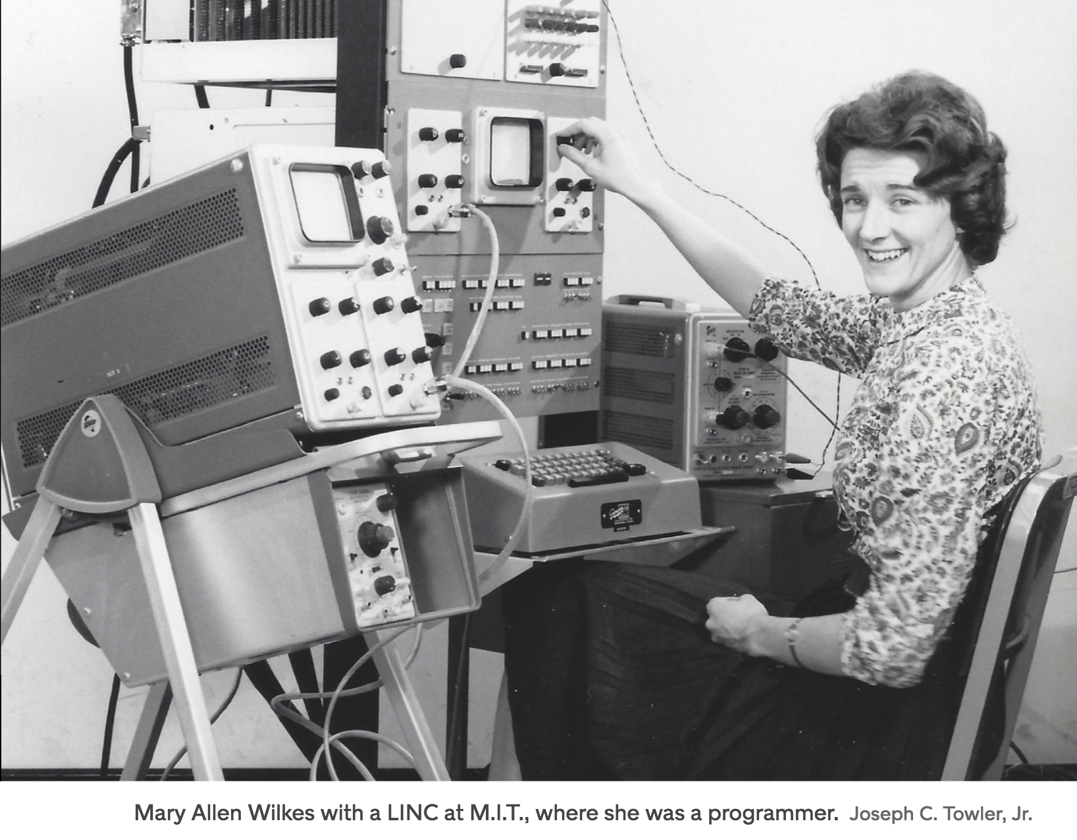
By the time she was graduating from Wellesley College in 1959, she knew her legal ambitions were out of reach. Her mentors all told her the same thing: Don’t even bother applying to law school. “They said: ‘Don’t do it. You may not get in. Or if you get in, you may not get out. And if you get out, you won’t get a job,’ ” she recalls. If she lucked out and got hired, it wouldn’t be to argue cases in front of a judge. More likely, she would be a law librarian, a legal secretary, someone processing trusts and estates.
Notes:
Stanford CS dept 1965

Slide 5

Notes:
The superfluous women who became stenographers and typists… surrounding infrastructures had to change to accommodate women
Senate house did not have a ladies room…
Fast Smart Connected – early forms – patented 1868
1881 – 8 typists women – supposedly are patient and slow making little errors
1886- 60,000 women – toilets , penny novels , entertainment ….

Slide 6
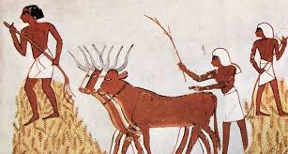
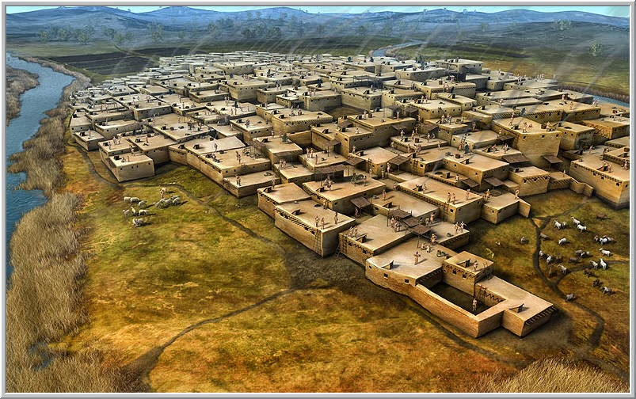
Notes:
Settling gender

Slide 7
Sex and Gender: Plumbing and glazed tiles
The biological package vs the sociological…
Notes:
Distinction – bio different – plumbing is different- undergirds the distinction
Unproblematic nature of the gender distinction…
Take on something that is hard to problematize…
The necessity of this- working with simplicities
Bio determined and cul/pol determined the right and wrong

Slide 8
Doing Gender
Going back to Duck - bunnyness…
Sorting Labelling – something that is not so STRAIGHT
Notes:
Sex vs gender
Bio packages vs sociological
Then dress up the display- dress – sipping tea – doing gender
Zimmerman & West - Doing Gender
Bio Exhibition Performance stuff
At all times and places
Expectations… but looks be deceiving…
Surface – physical – we invent the gender- complete the story and make someone this or that- living with DuckBunniness

Slide 9

Notes:
Duck and the Bunny
Duck seeing –cues indicators- human evolve socially- needs that external input

Slide 10




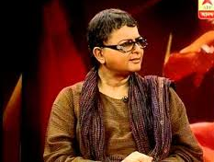
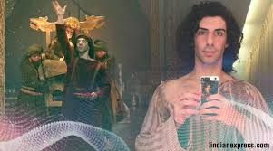


Slide 11
… but we get by and along with indeterminacy…
Notes:
What is a chair; car; bike; simplifying the fuzzy- to get by and along
We do not interrogate ‘fine’- we let it go…
Indeterminacy of sex/gender- more or less and categorize – cannot question everything every time
Labelling – lets study how is it achieved one way not another and not preach? Why so?
But… these differentiations have consequences…

Slide 12
Separating spheres…
PILOTS VS PERSONAL ASSISTANTS
CHEFS VS COOKS
Notes:
Then women can do certain kind of work …. Should reproduce --- hard ass distinction …
Women are nurturers; effective for raising children and not the world! Women/Gays in the military… be in battle ... Fly planes
Separate Spheres

Slide 13
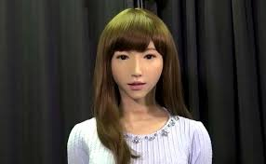



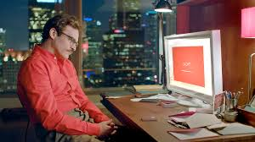
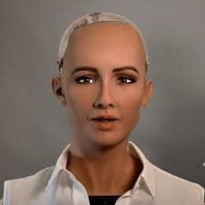
Notes:
What’s with technology and personal assistants

Slide 14
Credit card! Women did not receive one in their name up until the 1960s

Slide 15

Wages occupations class gender
Notes:
Less money for the same job; separate job/occupations- doctors and physicians- bio differences – medicine and doctoring
Making critical decisions- integrating science knowledge with practice- man’s job
Pay – where is the doctor paid more? Where women are doctors the wages are less – USSR UK and USA
Manning nor doctoring…
Deciding what to pay – child care and plumber- is it a function of the importance of what’s going on …
Comparable worth – seen as what men do- worth as much…

Slide 16
Notes:
video

Slide 17
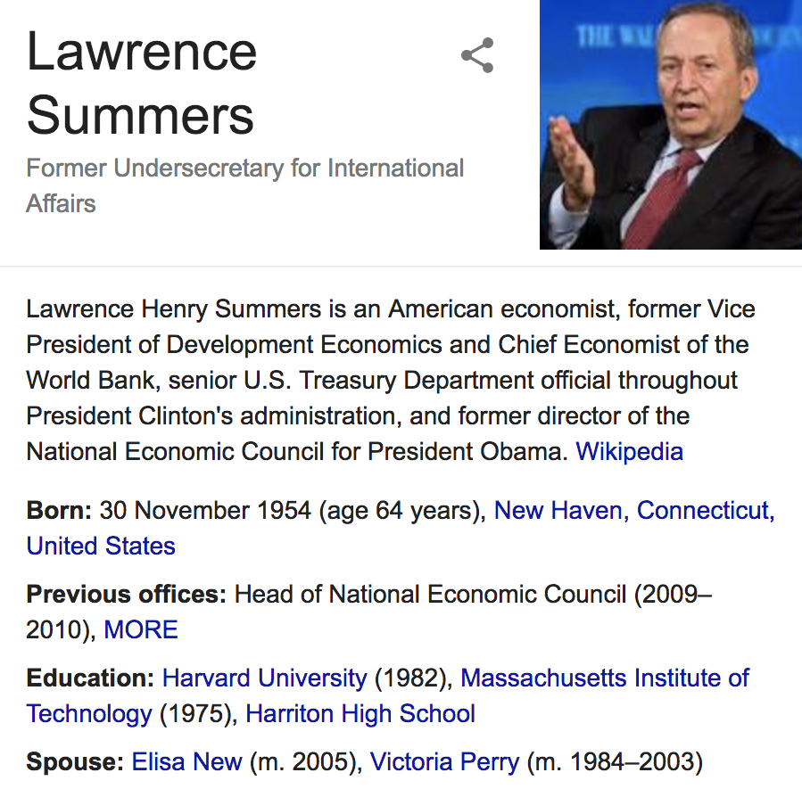

Notes:
The president of Harvard University Lawrence Summers – trucks were called mummy and daddy
Research in behavioral genetics

Slide 18
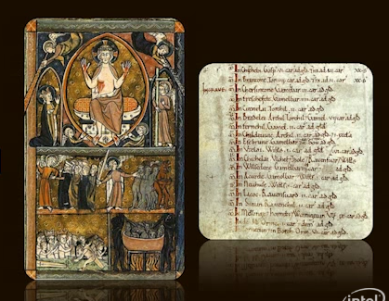
Notes:
The doomsday book in 16 century UK and the first census
– 1085 AD- Ed Wood – Harold Bro in law- William of Normandy
How to survey a kingdom- w asks his generals for ideas- full survey- questionnaire – land Slaves Sheep Cattle- scribes Monks Bureaucrats – 7 months 13000 settlements- missing- no women in the survey – children- church- People don’t answer- No London or Winchester because nobody is in charge of them
Now proof! What and who they say they are…
Fights! Docs get composed- winchester roll- becomes part of the roll- day of judgement – do you have land or not? Doomsday book
Difficult moment – recolving propriety – Winchester roll- the King’s roll
owners responsibiliteis taxes army - Whole new ways of thinking – manors ownership holder - not geographic – not where you where- but who you were? 1086 Scope and size of England – two boooks – 900 sheep
Record in perpetuaity – 1087 William dies- next 200 years appeared in court – to reference / consult- updattion – shaped English life- tax-land tenure- realtioship between monarch and ciizens- referred to in 1960’s- National archive in London – you can visit it?
Can a punch card be read today? Magnetic tape? Floppy discs? Hard discs? Will the data be relevant?
Good for 1000 years – what relevance – are you makigng something like that? Make sense of what we are doing?

Slide 19
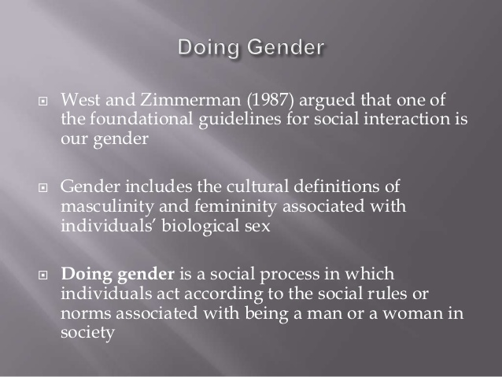
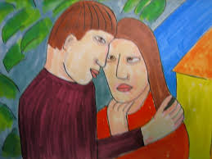
Notes:
No problem of duck- bunny-ness in gender perceptions
If there is a fuzziness we complete the picture – we make the fit
I see a world of males and females – we constitute our own identity and anticipate the same from others
We catch the cues and respond- the clap trap and applause…. Hard to get out of it

Slide 20

Notes:
Tall men and short women across the board – we are making gender norms everyday… something that is not exceptional
Hardening the bio differences- how is it we are coupling up as universal… making it true … one vision of reality…
The varsity in Dubai
Distinctions based on the plumbing – contesting the plumbing the gender and what is done with the differences
Structuring places- society Occupations Spaces – office university ….

Slide 21
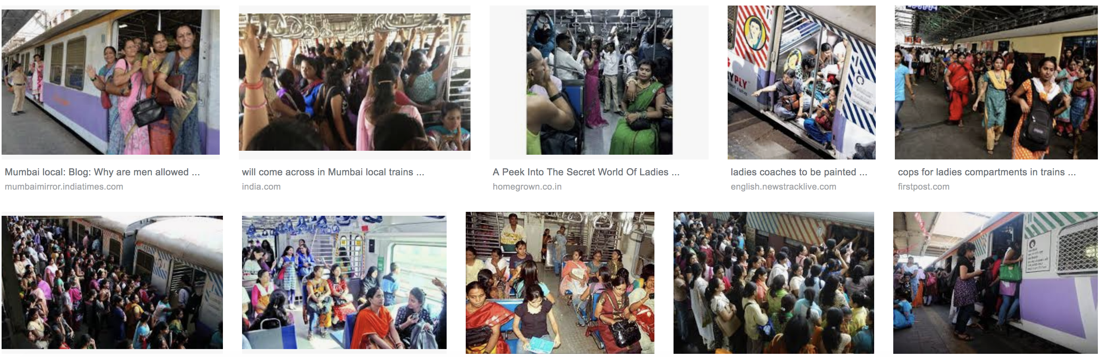
Power of conformity to gender classification
Notes:
Back stage for women- rest room – more time to groom or even cleansing – apparatuses are different- toilets for women a historical view
Question of acess- space- time – to fulfill bodily function
How to give acess to groups-reservations!
Taking over men’s rooms
Power of conformity to gender classification- they don’t go to the men’s
The ladies compartment and seats in India- enacting maleness and femaleness
Re org the social and infra arrangements- equal capacities and resources

Slide 22
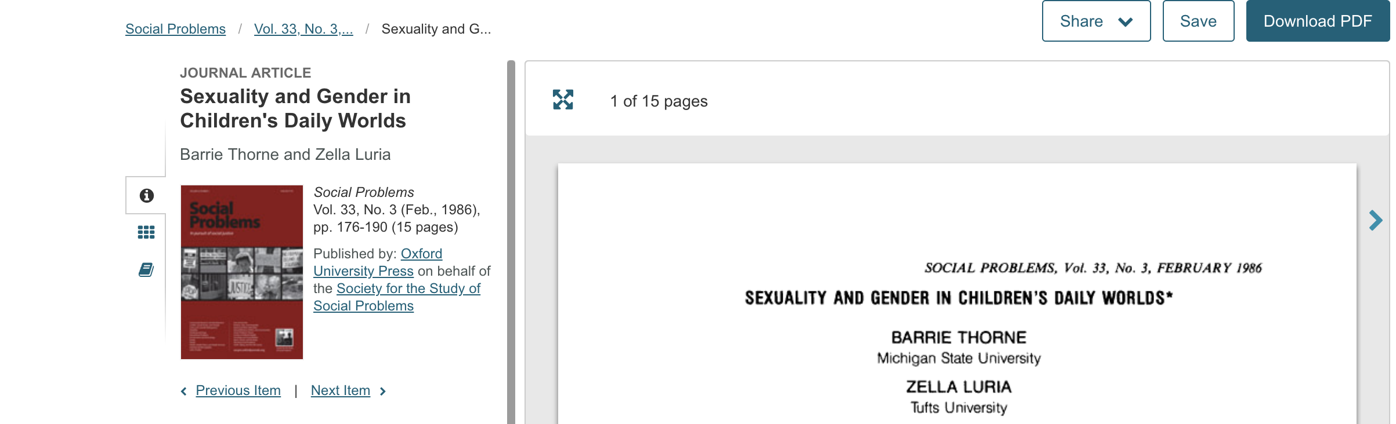
Rest Rooms… gender in the public and private
Structuring the work place US senate house had not women's toilets in the 50s
Notes:
Should we deconstruct…Barry Thorn and Zella Loria
Toilet segregation in public – not at home. Preoccupation with separating men from women – you are making a choice of which gender you are…
Distinction that is natural/bio – we need categories- consequences. Who is in what where etc.…
Arguably bio and then adding on interpretations- what might that mean…
What can be done…
Structuring the work place – US senate had not women's toilets…

Slide 23
Achieving equality through unequal acess
To get equal opportunities for individuals you had to bring inequality to groups
Notes:
Achieve equality through men
Can we remove these inequality how? Radical liberal ….
Re org the bathrooms and reorg social relations/arrangement ??? Men standing in line and parenting …

Slide 24
Toilet without doors! equality of acess and genders
Notes:
Radical re org!!!! From toilets with out doors to paternal leave
The kibbiutz- radical child care – community raises the children – will there not be bias- are there no social bias?

Slide 25
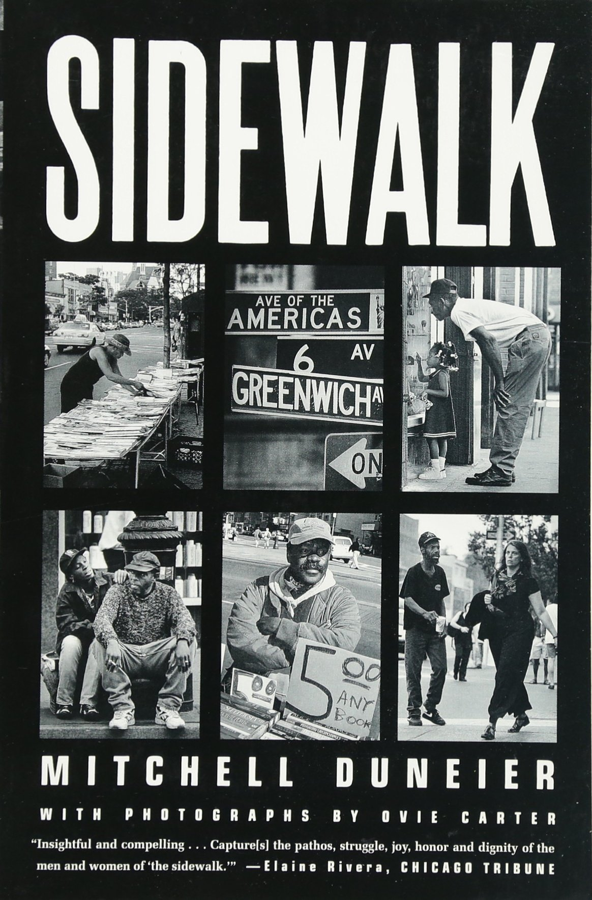

Slide 26


Slide 27
The open person in a gendered world…
Notes:
Michel Duneier – a stranger coming on or comment
Open person or a store – walk up to a dog and talk- not offensive – child next in order – Open person – women – open compared to mean and at least to men – women being open is ratified no?

Slide 28
Does sociology teach you to accept structures and move on…
Notes:
Making society as your proceed through it- in terms of their own statuses and being
Ratifying the social structure – sociologists have called it ...
How does this all work? To what degree is everything determined? If we are born poor do we die poor?
Discrimination processes of deprivation ensure structure …
Sociologists are happy to talk about structure- but not about individual’s opportunity to go beyond and break it!
But some do Gully Boy…

Slide 29


Slide 30
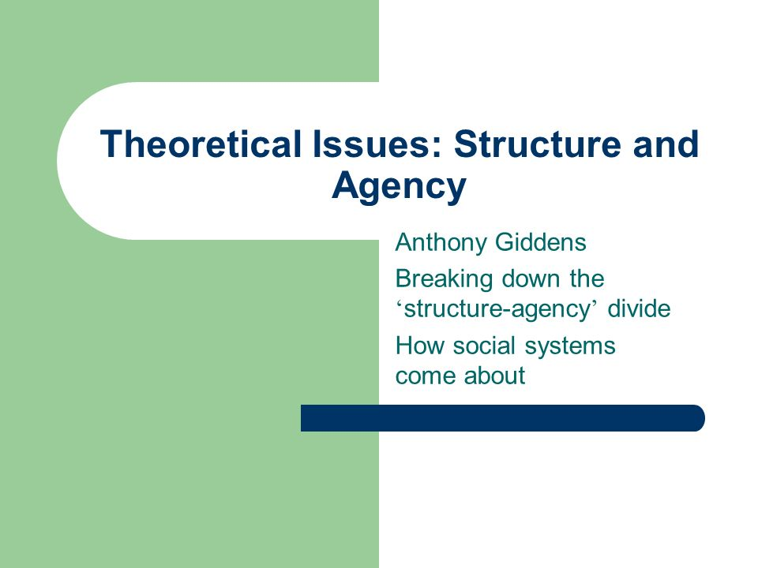

Slide 31
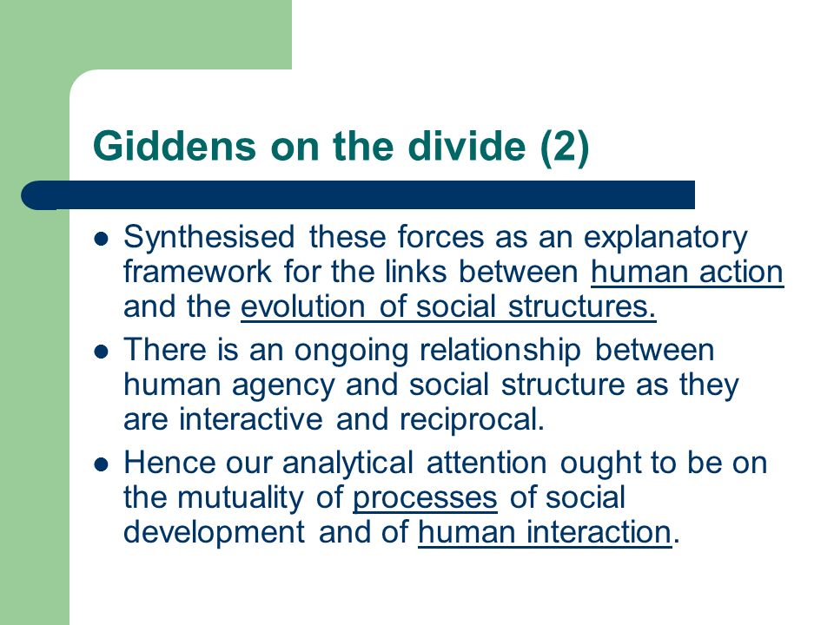
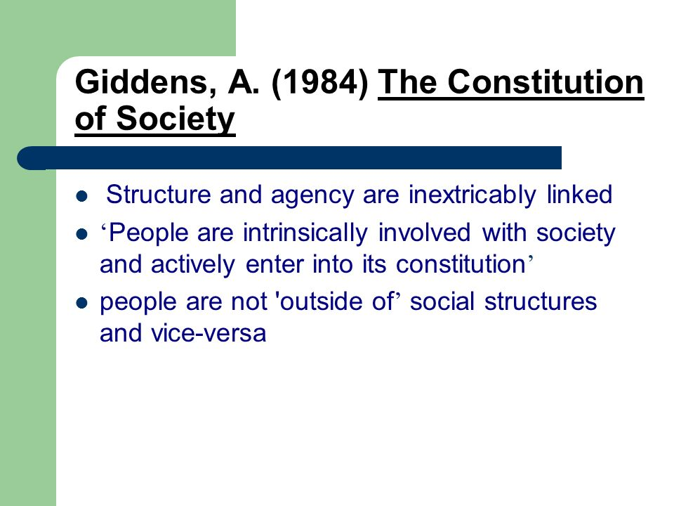

Slide 32
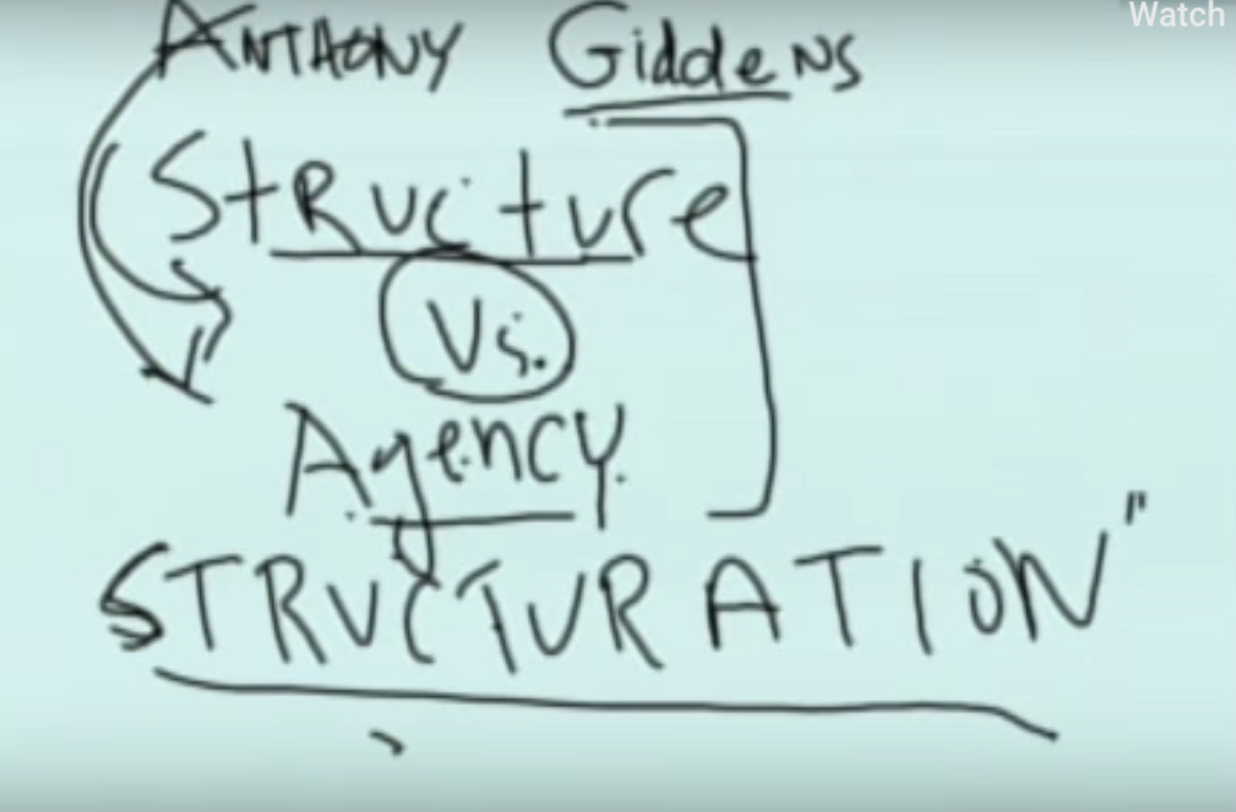
Notes:
Structure vs Agency – or both at the same time… making and re making ….
We make the very structures that make us
Ladies compartment the public road/street Rest rooms Child care
Texture and tones of agencies and enactment looks different
What do we do each other in the everyday?
Making moves through individual agency operates to enforce structure – which then shapes agency itself – what does it lead to or impacts our socio-political behavior? Becoming conservative or liberal based on street behaviors that are gendered
Structuration – structuration/structuring .
Determinism vs free will

Slide 34
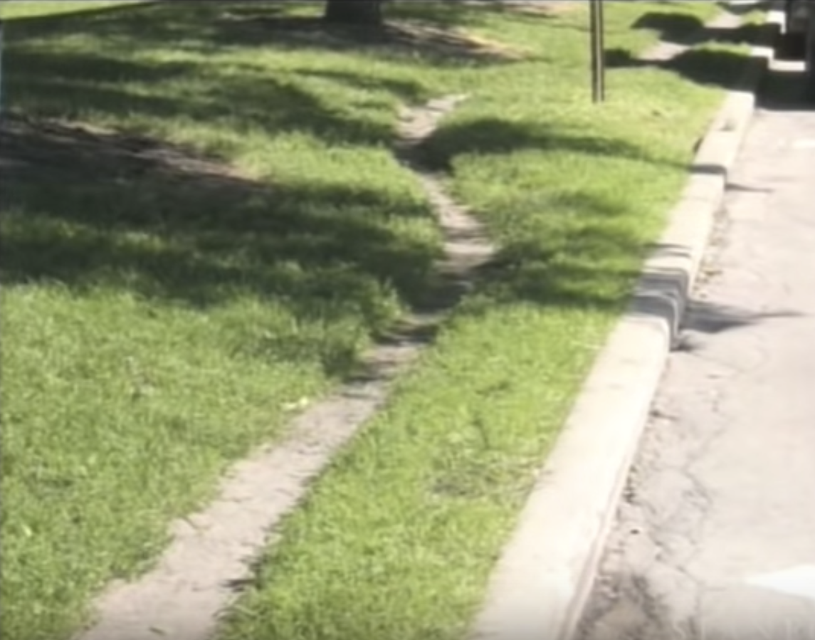
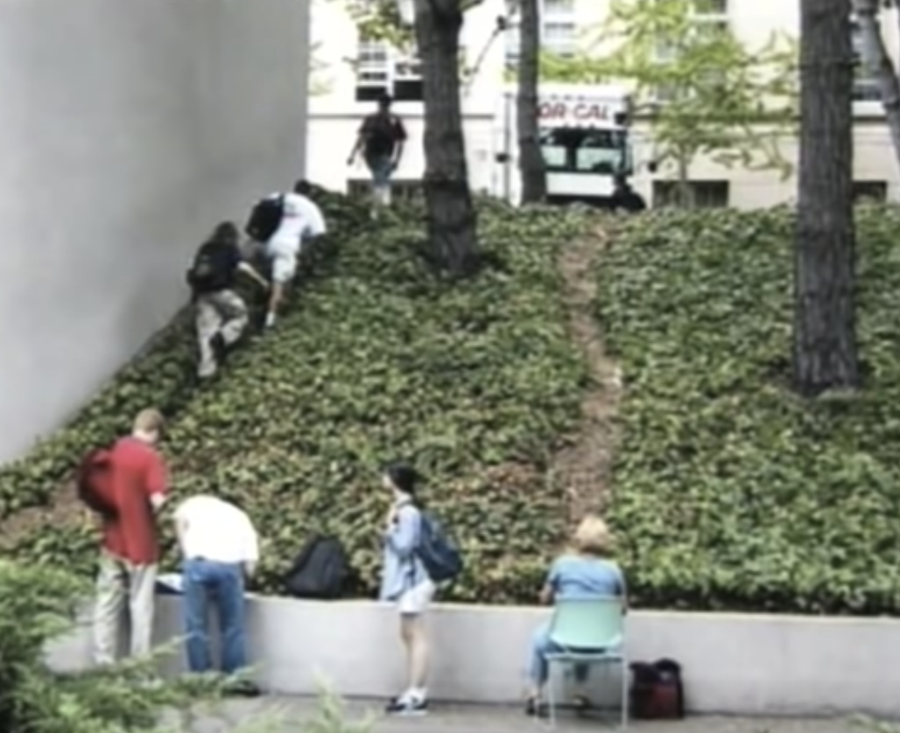
You are not alone…
Notes:
All of sociology is to explain how people have no choice – gender class race have structures that is forced constrain etc.…
Structure and Agency… it is a single thing – no binary here- what is it with out each other …. It’s a process… workings of life
Images on user generated paths form SSPHCI
Beginnings of the path that connects to the bigger one… structures change due to social behaviors Habits
The alternate path is an invitation…
A short cut – you can so it too- you don’t need the law but is it illegal? But people do it because people before them did it…
Agency of people reinforcing creating structure pushing behaviors … to follow…
Create structures that in turn creates us…

Slide 35
